Slide 1
Understanding OOP, Classes, Main principles. Modules, Include. Prepend. Extend. Mixins
by Dmytro Dobrietsov

Slide 2
Agenda
OOP & Classes
Classes
Objects
Main principles
Encapsulation
Inheritance
Polymorphism
Abstraction
Types of Methods in Ruby
public
private
protected
Modules in Ruby: Include, Prepend, Extend, and the Magic of Mixins
Mixins
include
prepend
extend
Cool examples

Slide 3
OOP & Classes

Slide 4
Types of Programming
There are many types of programming:
1. Functional (Haskell, Scala, Erlang, Elixir)
2. Procedural (C, Pascal, Fortran)
3. Structured (C, Java, Python, G)
4. Declarative (SQL, HTML, CSS)
5. Event-driven (JavaScript)
6. Logical (Prolog, Mercury)
7. …
8. PROFIT Object-Oriented programming
(Ruby, Java, Python, C++, C#)

Slide 5

What is this OOP?
OOP (Object-Oriented Programming) is a way of writing code by thinking not about a set of functions but about objects that can interact with each other.
Imagine you are playing a computer game (for example, an RPG), and you have a character – let’s say, a mage. This character:
Has properties (name, health, level, mana, stamina, popularity)
Can perform various actions (methods), such as walking, casting spells, and getting nervous before presentation.
An object in OOP is exactly like our character, with all its capabilities and characteristics.

Slide 6
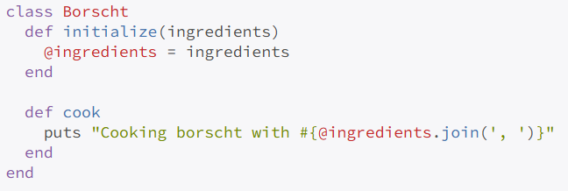
What is a class? Or a programmer's recipe
Imagine that a class is a recipe for your favorite dish, like borscht or pizza.
A borscht recipe itself is not borscht, right? It’s just an instruction: what ingredients are needed, how to mix them, and how long to cook them.
In OOP, this “recipe” is what we call a class. In Ruby, it looks something like this:
A class describes what and how something will be done, but it does nothing on its own until you create an object.

Slide 7
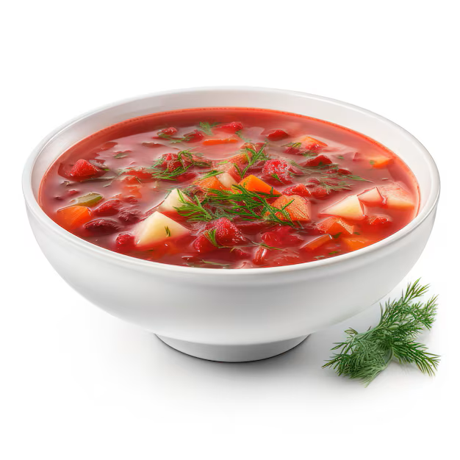
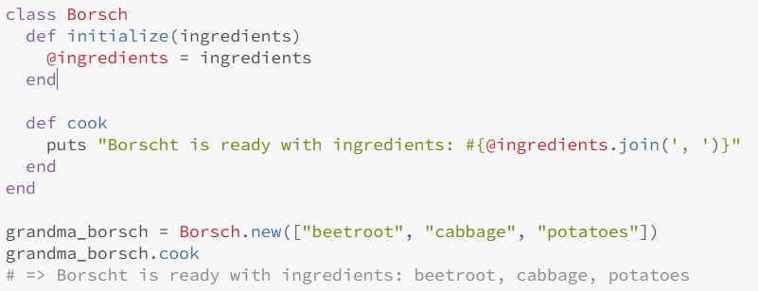
Objects: When the Recipe Comes to Life
Now imagine: you read the recipe and decided to cook borscht. And this real, hot, aromatic, ready-to-eat borscht is an object.
That means:
Class – the recipe for borscht.
Object – a specific bowl of ready-made borscht on your table.
Example in Ruby:
You created an object (grandma_borsch) based on a class (Borsch), and now this object can do what is defined in the class.

Slide 8
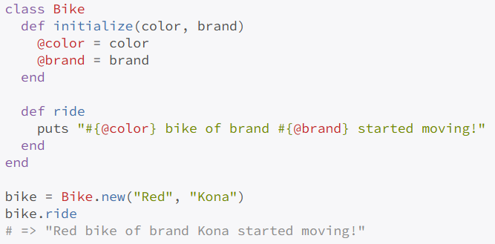

Properties and Methods: Details and Functions
Every object can have:
Properties (variables): These are like characteristics. For example, a bicycle might have properties like color, brand, and number of gears.
Methods: What the object can do (ride, brake, fall).
For example:
Illustration of brake function:

Slide 9

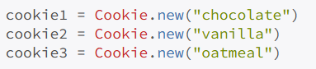


One Class — Many Objects
One of the key features of OOP: you create a class once, but you can generate as many objects from it as you like.
Imagine that a class is a cookie cutter 🍪. You make the cutter once, but you can bake 100 cookies with it.

Slide 10
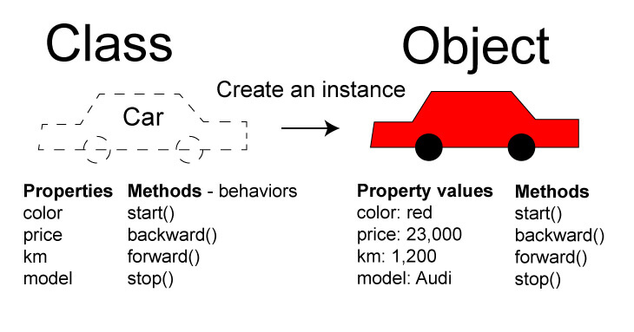
What to Remember (To feel like a pro 😎):
Class – a recipe, template, or mold for objects.
Object – a specific instance of a class created based on that template.
Each object is unique (like a pizza: they seem the same, but each one tastes slightly different).
Methods – what an object can do.
Properties – characteristics that describe an object.

Slide 11
Main principles

Slide 12
OOP is based on four main principles, which are easy to remember:
Encapsulation
Hiding an object's internal state and implementation details from the outside world.
Example: You use a microwave by pressing buttons on the outside without knowing how it works inside.
Inheritance
A mechanism for creating new classes based on existing ones while inheriting their properties and methods.
Example: A child inherits their parents' eye color.
Polymorphism
He ability of one interface to take different forms and perform different actions.
Example: The same USB port is used to connect various devices (phones, mice, keyboards, etc.)
Abstraction
Focusing on the essential characteristics of an object while ignoring irrelevant details.
Example:When talking to a random person in a themed chat, for example, about photography, you don’t care about their gender, height, skin color, or even whether you’re talking to a human. For you, it’s just a conversation partner.

Slide 13
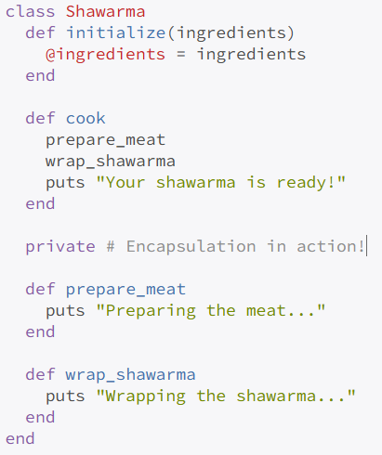
Encapsulation
Encapsulation is when you hide implementation details and expose only what’s important.
Real-life example: Imagine ordering a shawarma. You don’t care how exactly it’s made in the kitchen (and maybe it’s better not to know), you just want a delicious meal. The same applies to programming: you use methods without thinking about how they work inside.
In Ruby, it looks like this:
You simply call the cook method, while the details are hidden behind private. Just like a chef doesn’t reveal all the secrets of their recipe (and that might actually be for the best).

Slide 14

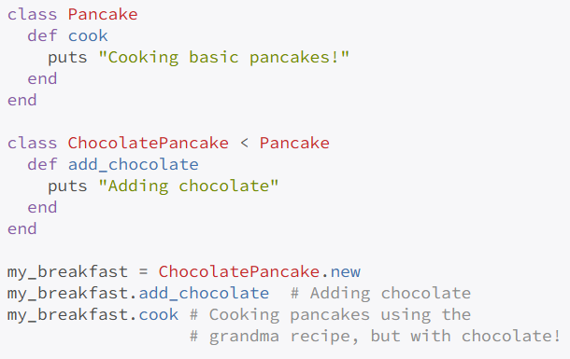

Inheritance
This is when you inherit something from your parents, older siblings, or even your grandmother. In programming, it's very similar.
Here, ChocolatePancake inherits everything from Pancake and adds its own features.

Slide 15
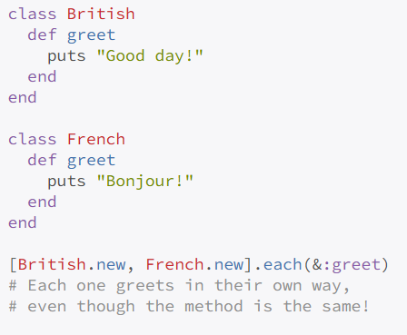
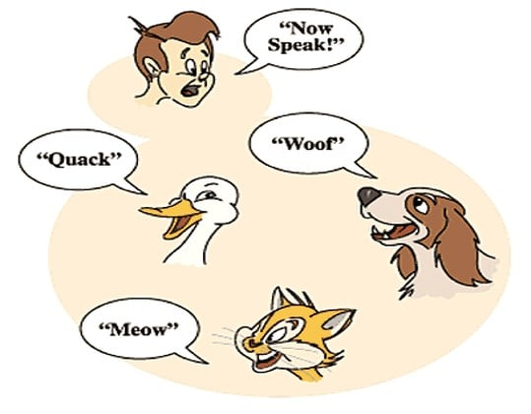
Polymorphism
This is when one action (a method) can look different depending on who performs it. Like greetings in different countries:
A Brit says: "Good day!"
A French person says: "Bonjour!"
A Japanese person says: "Konnichiwa!"
In Ruby, it looks like this:

Slide 16

Abstraction
Abstraction is focusing only on the most important details. You don’t explain to your mentor every detail of what was discussed at a Git training meeting on Saturday. You just say: "We worked with Git." That’s abstraction.

Slide 17
Types of Methods in Ruby

Slide 18
Types of Methods in Ruby (public, private, protected)
Now, let’s talk about the different types of methods in a class and why access modifiers are needed.
Imagine your class as a house:
public – the main entrance, accessible to everyone.
private – your personal room, where no one is allowed.
protected – your sibling’s room: outsiders aren’t allowed, but family members can enter!
Let’s break it down in more detail.

Slide 19

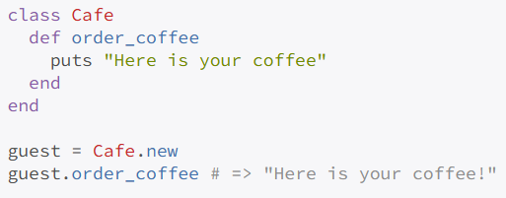
Public Methods
These methods are accessible to everyone—like the doors of a store.
order_coffee is a public method that anyone can call.
Here are a few simple analogies for a public method:
Elevator call button – available for everyone to use.
Doorbell – anyone can ring it if they need to.
Restaurant menu – all visitors can choose dishes from the list.
TV remote – openly lying on the table, allowing anyone to change channels.
ATM buttons – publicly accessible and can be used by any bank customer.

Slide 20
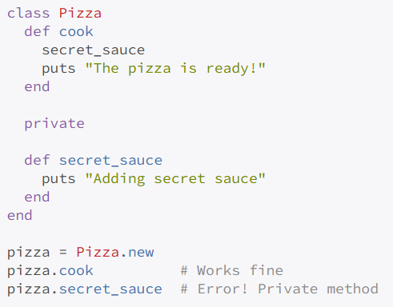
Private Methods
Private methods are internal mechanisms that are not exposed to the outside world. Think of them like the secret sauce recipe in a pizzeria.
In Ruby, it’s done like this:
Here are some simple analogies for a private method:
Secret recipe – only the chef knows it, guests only see the final dish.
Safe password – known only to the owner, no one else can use it directly.
Internal parts of a car engine – the driver doesn’t interact with them directly, only with the steering wheel and pedals.
Staff entrance in a store – accessible only to employees, while customers use the main entrance.
Personal thoughts – only the person has access to them, no one can read them directly.

Slide 21
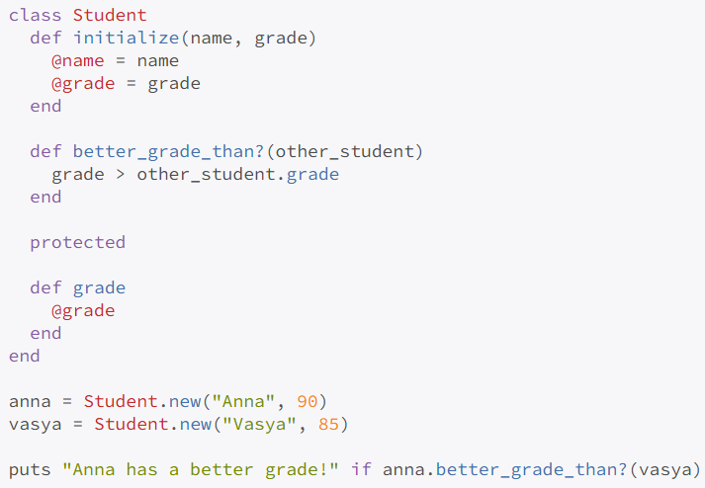
Protected Methods
Protected methods are a bit special: they are inaccessible from the outside but can be used by other objects of the same class.
Imagine you're a student comparing grades with a friend. You can discuss your grades with each other (since you're "kindred spirits"), but an outsider shouldn’t know your scores.
Example:
Here are some clear analogies for a protected method:
Home Wi-Fi password – available to family members and close friends, but not to strangers.
Office shared kitchen – all employees can use it, but visitors cannot.
Family car – any family member can drive it, but it's off-limits to outsiders.
Company shared folder – accessible only to company employees, not external users.
Apartment key – only available to residents and their close ones, not to strangers.
Here, the protected method allows objects of the same class to access each other’s data, but it doesn’t expose it to the outside world.

Slide 22
Modules in Ruby: Include, Prepend, Extend, and the Magic of Mixins

Slide 23
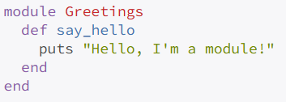
What is a Module and Why Do We Need It?
A module in Ruby is a way to package reusable code and use it in multiple places.
Imagine you have a backpack full of useful skills. You can take this backpack anywhere—school, the gym, a party—and it will be helpful everywhere. That’s exactly what a module is!
A simple example:
Here’s a clear set of analogies for a module in Ruby:
Toolbox – you can take tools and use them in different situations.
Set of spices – used in different recipes to give dishes the desired flavor.
Artist’s brush set – you choose the right brush depending on the painting you want to create.
Screwdriver set – you pick the screwdriver that fits a specific screw.
Swiss Army knife – a compact multi-tool for various situations.
Font collection – you use different font styles depending on the task.

Slide 24
Mixins – or How to "Mix In" a Module into a Class
When we include a module in a class, we create a mixin. It’s just like making a cocktail: you take juice (a class) and mix in a module (include, prepend, or extend). The result? A new, improved functionality!
Let’s explore the three ways to mix in a module:
include
prepend
extend

Slide 25
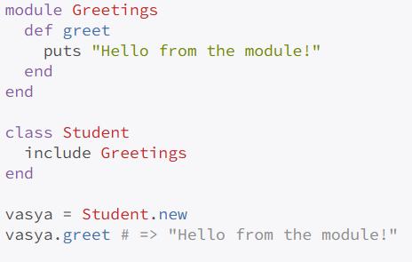
Include – Adding Methods to Objects!
include adds a module’s methods as instance methods to the objects of a class.
Imagine a class as a cocktail and a module as a flavored syrup. include mixes the syrup inside, so every drink gets the flavor.
Simple and clear: when you include a module, its methods are available in every instance of the class!

Slide 26
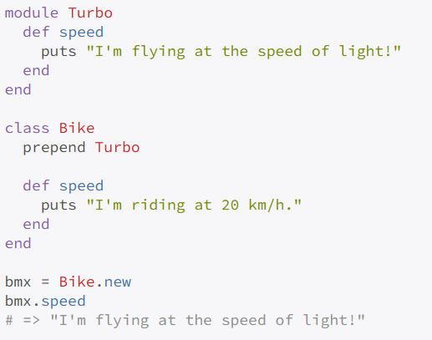
Prepend – "Can I Cut in Line?"
prepend is similar to include, but it places the module’s methods above the class’s own methods.
That means the module’s methods override the class’s methods when called.
Real-life analogy: You’re standing in a cafeteria line, and someone says, "I just have a quick question!"—and jumps ahead of you.
Example:
Here, the module rudely cuts ahead of the class’s method and overrides its behavior.

Slide 27
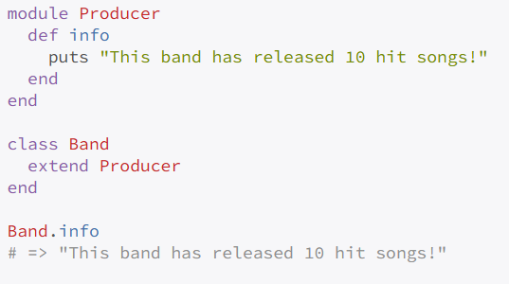
Extend – Superpowers for the Class Itself
extend makes module methods available to the class itself instead of its instances.
Analogy: A class is like a music band. When you extend a module, it becomes the band's producer, managing the entire group, not just individual musicians.
Now, the module’s methods work directly on the class level, not on instances.

Slide 28
Visual Summary Table
What We Write? | Where Methods Appear? | Real-Life Example
include | In objects (instances) of the class | Sugar in coffee: every cup is sweet.
prepend | Also in objects, but with higher priority than class methods | VIP pass at a club: module methods run first, overriding class methods.
extend | At the class level | A producer managing the entire band.
Why So Many Ways?
Each method serves a different purpose:
include – the most common; simply adds methods to all instances of a class.
prepend – useful when overriding class methods without modifying the class itself.
extend – perfect for adding class-level functionality (e.g., helper methods that don’t depend on instance data).

Slide 29
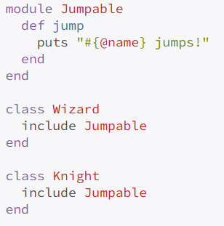
Real-Life Example: Modules & Mixins in Game Development
Imagine you’re creating a game with different classes: Wizard, Knight, Elf. They all need a jump ability. Instead of copying the same method into every class, you create a module and mix it in:

Slide 30
Key Takeaways:
A module in Ruby is simply a container for methods to avoid repetition.
include adds module methods to instances of a class.
prepend is similar but takes priority over class methods.
extend makes methods available at the class level, not on instances.
And remember: Mixins aren’t "programming magic"—they’re just a tool to help write cleaner, more flexible code!

Slide 31
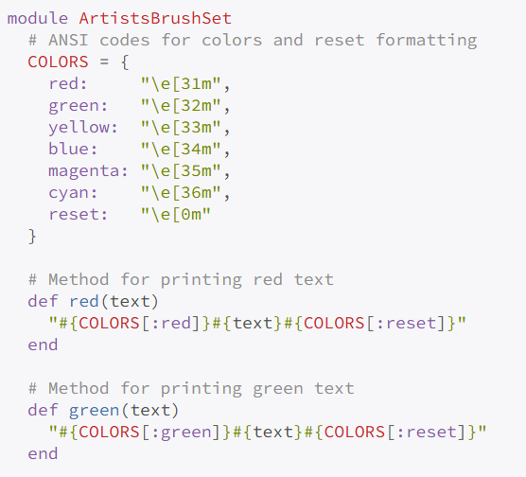
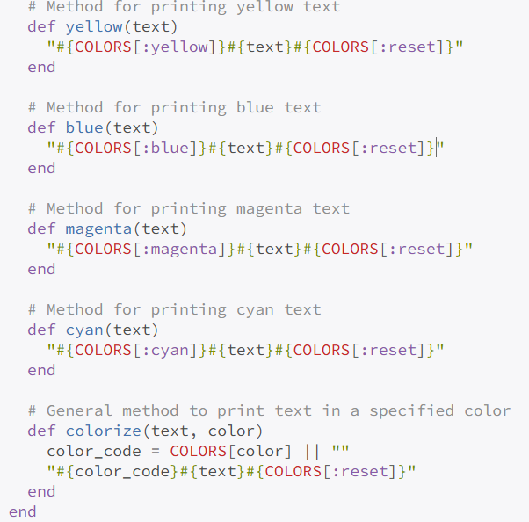
Cool example: Module
Below is an example of a module that could be called ArtistsBrushSet. It contains a set of methods for printing text in different colors (using ANSI codes). I will also show an example of a class that includes this module (via include) and how its methods can be called from an instance of the class.

Slide 32
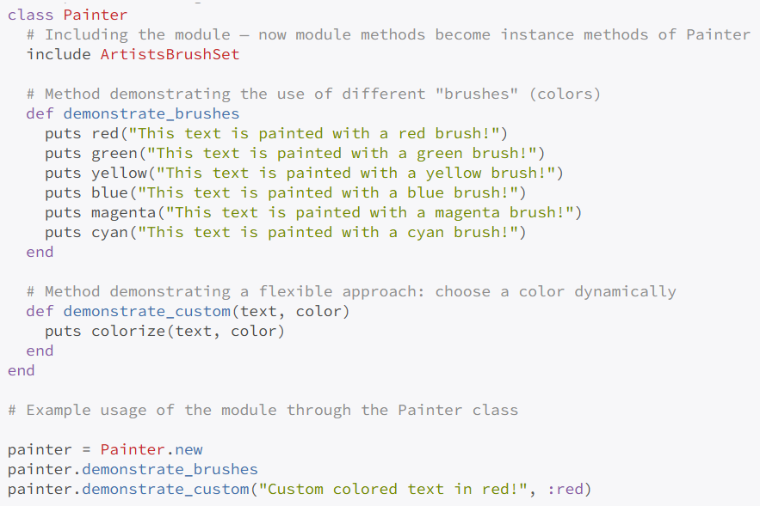
Cool example: Class

Slide 33
Cool example: Explanation
ArtistsBrushSet module Contains methods that take a string and return it wrapped with ANSI codes for the corresponding color. The colorize method allows for dynamically choosing a color using a symbol (e.g., :red).
Painter class
Includes the module using include ArtistsBrushSet, making all module methods available as instance methods.
Implements two methods:
demonstrate_brushes – prints text in predefined colors.
demonstrate_custom – uses the colorize method to allow specifying the desired color as a parameter.
Example usage If the file is executed directly (ruby artists_brush_set.rb), an instance of Painter is created and prints text in different colors.
This module can be expanded by adding new methods for additional colors or formatting as needed.

Slide 34
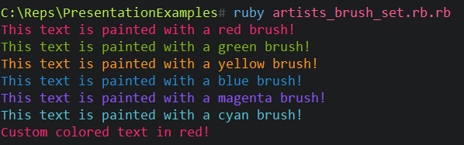
Cool example: Output

Slide 51












WE SPECIALIZE IN
ENGINEERING SERVICES
CLOUD/DEVOPS
BIG DATA & ANALYTICS
AI & ML
INTERNET
OF THINGS
EXPERIENCE
DESIGN
CYBERSECURITY
EXERIENCE PLATFORMS
EXTENDED
REALITY (XR)
RESEARCH & DEVELOPMENT
SOFTSERVE INNOVATION PLATFORM™
ROBOTICS

Slide 53


GLOBAL NETWORK
STOCKHOLM
OUR PEOPLE MAKE THE DIFFERENCE
TORONTO
GDAŃSK
CHICAGO
WARSAW
UTAH
WROCŁAW
BIAŁYSTOK
LONDON
BERLIN
RIVNE
KHARKIV
MASSACHUSETTS
KYIV
FRANKFURT
DNIPRO
GLIWICE
LVIV
VINNYTSIA
KRAKOW
AUSTIN
UZHGOROD
CHERNIVTSI
ODESA
FORT MYERS
BUCHAREST
IVANO-FRANKIVSK
SOFIA
GUADALAJARA
MEDELLIN
DUBAI
SANTIAGO
SINGAPORE

